Slide 1


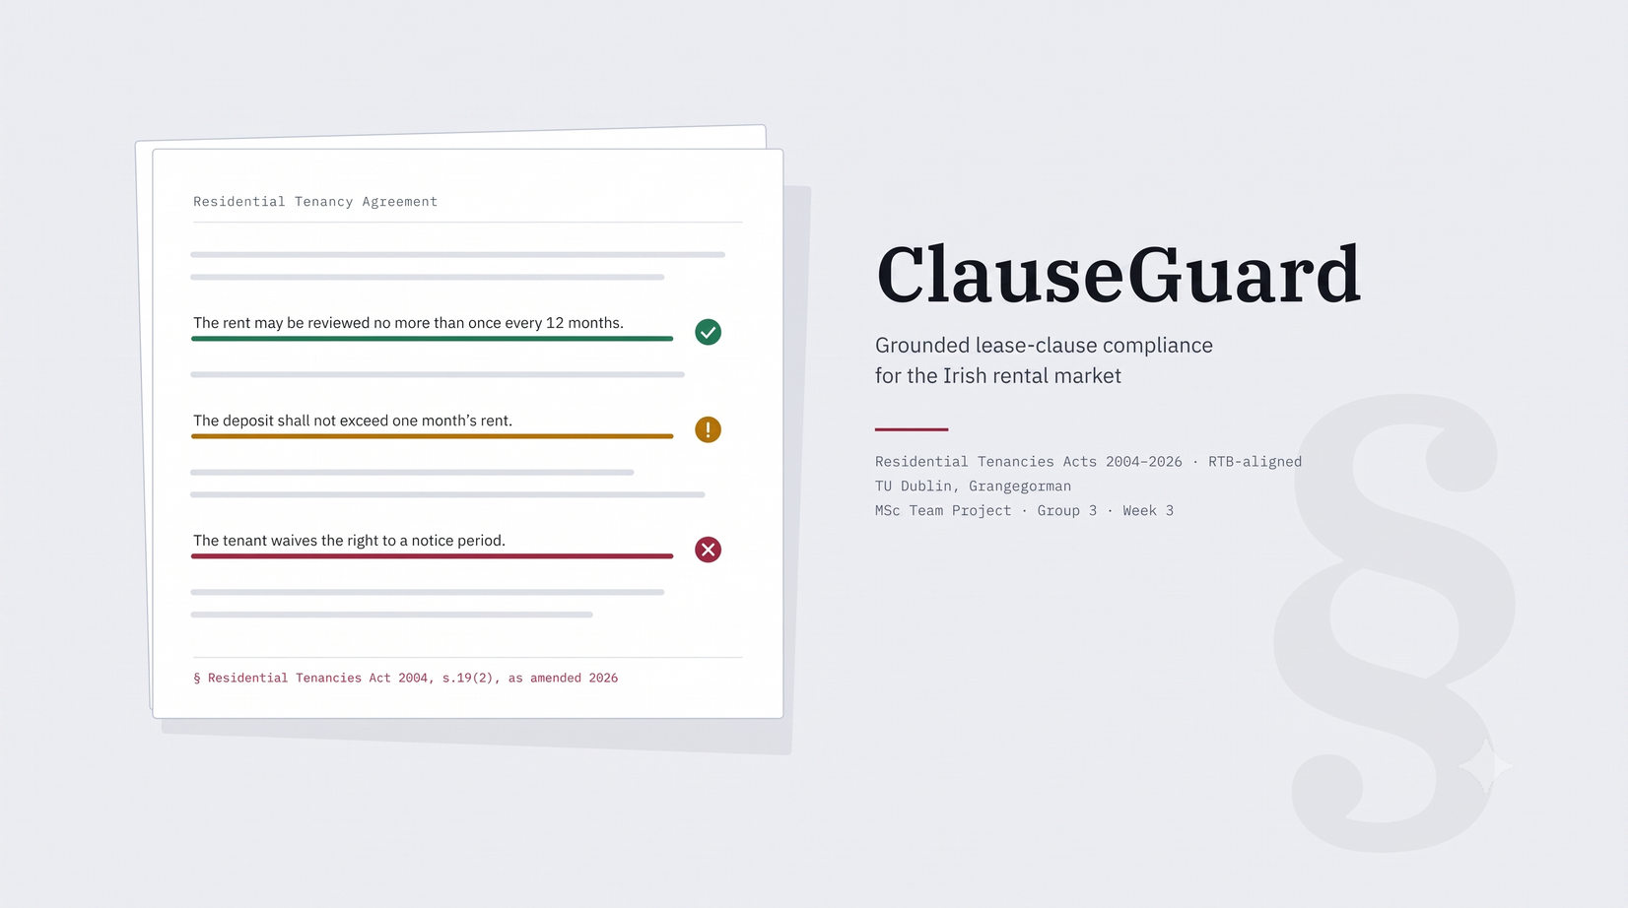
GROUP 3
SHUBHAM(A00047193)
SIDDHARTH(A00047237)
PRASAD(A00047190)
JUDE (A00046791)
KARTHIK (A00046404)
CLAUSEGUARD UPDATES
DETERMINISTIC COMPLIANCE FOR IRISH PRIVATE RENTALS

Slide 2

DOCUMENT CHECKER AND INTEGRATION
3
Need to complete the hybrid OCR pipeline to reliably process physical scans, map the Template Diff Engine output and complete end-to-end tests with scanned PDFs and images directly feeding to the model.
Wrote the difflib Template Diff Engine for regular RTB warnings text.
1
4
Also need to work on scheduler to send out notification warnings for 7 days RTB timeline events.
2
Currently, the redaction of PII data being performed after scanning from OCR is being tested on and developed.
5
Need to complete the End-to-end integration architecture (Frontend to Gateway to Modules to DB).

Slide 3
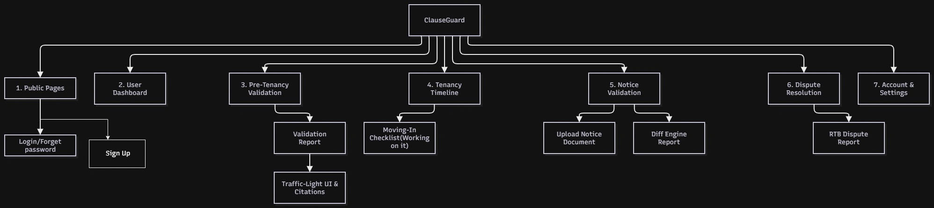
SITEMAP

Slide 4
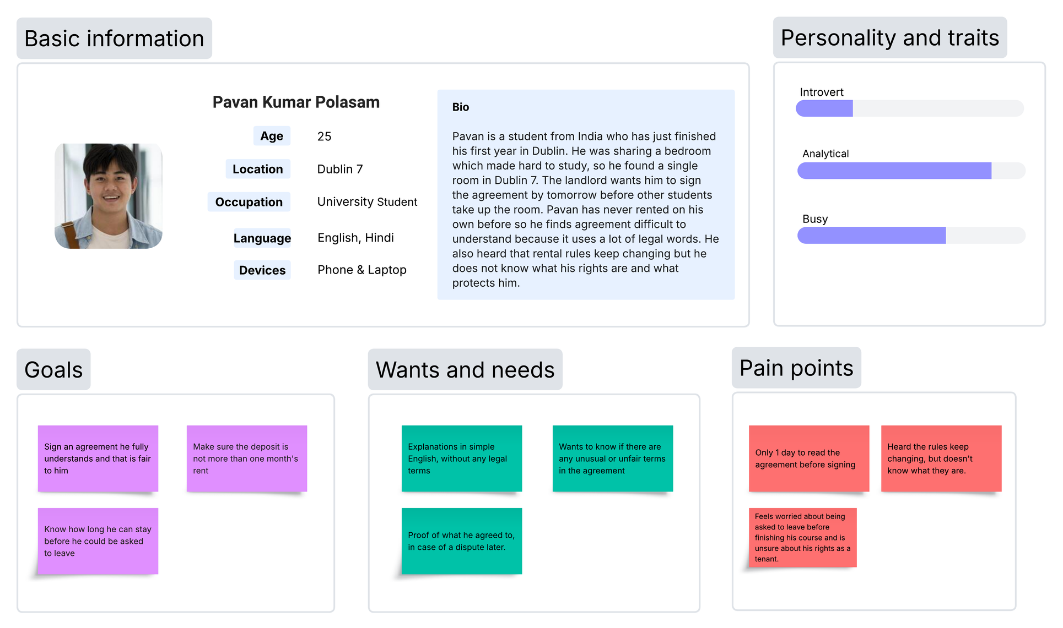
USER PERSONA 1

Slide 5
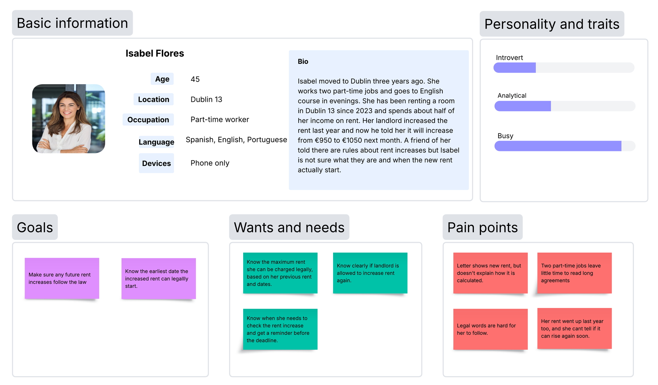
USER PERSONA 2

Slide 6
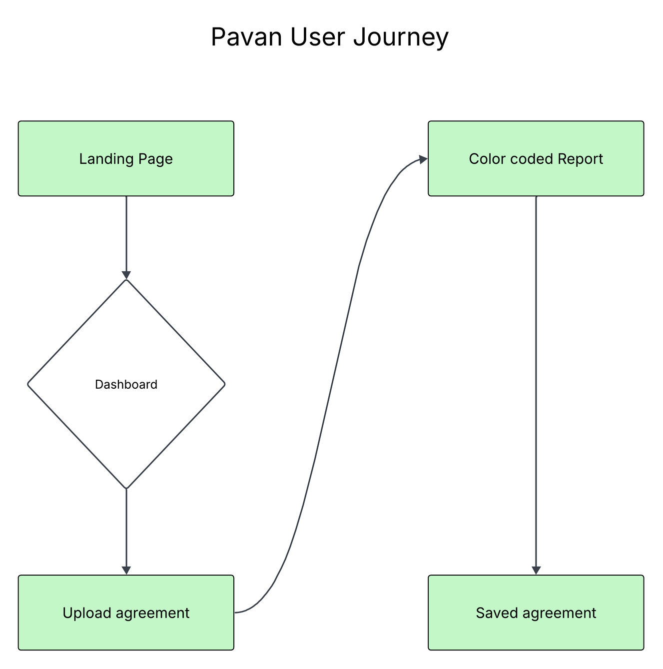
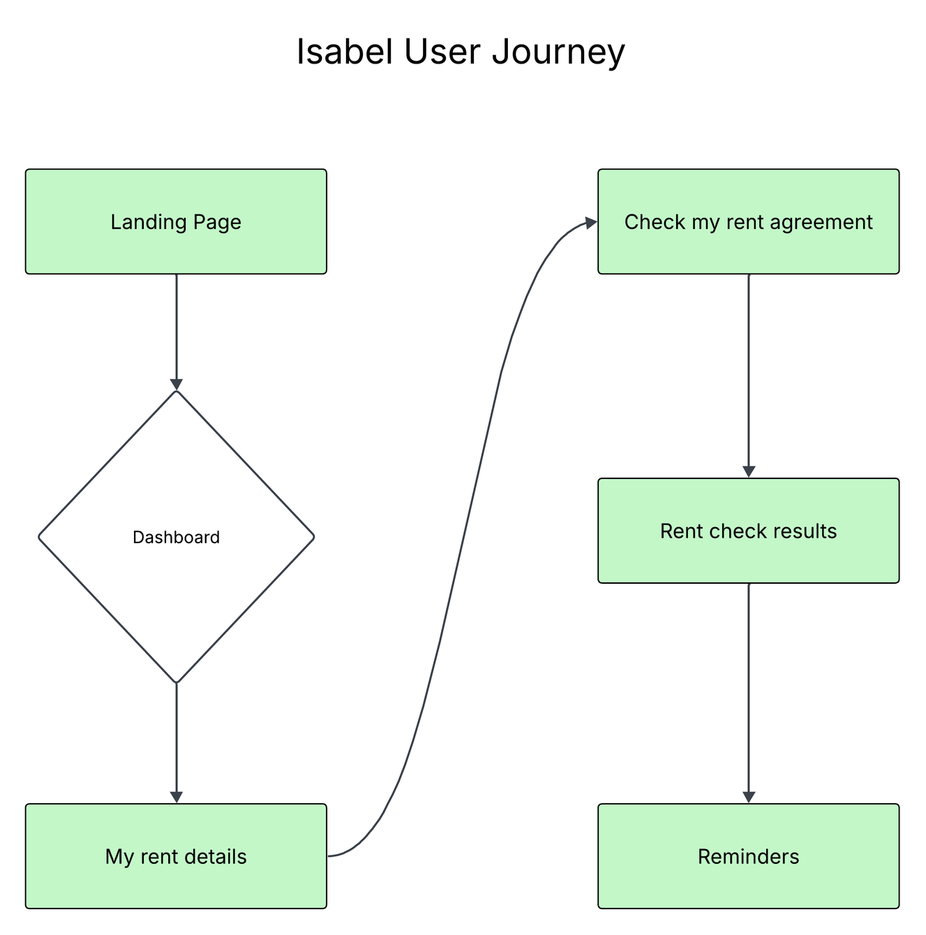
USER JOURNEYS

Slide 7
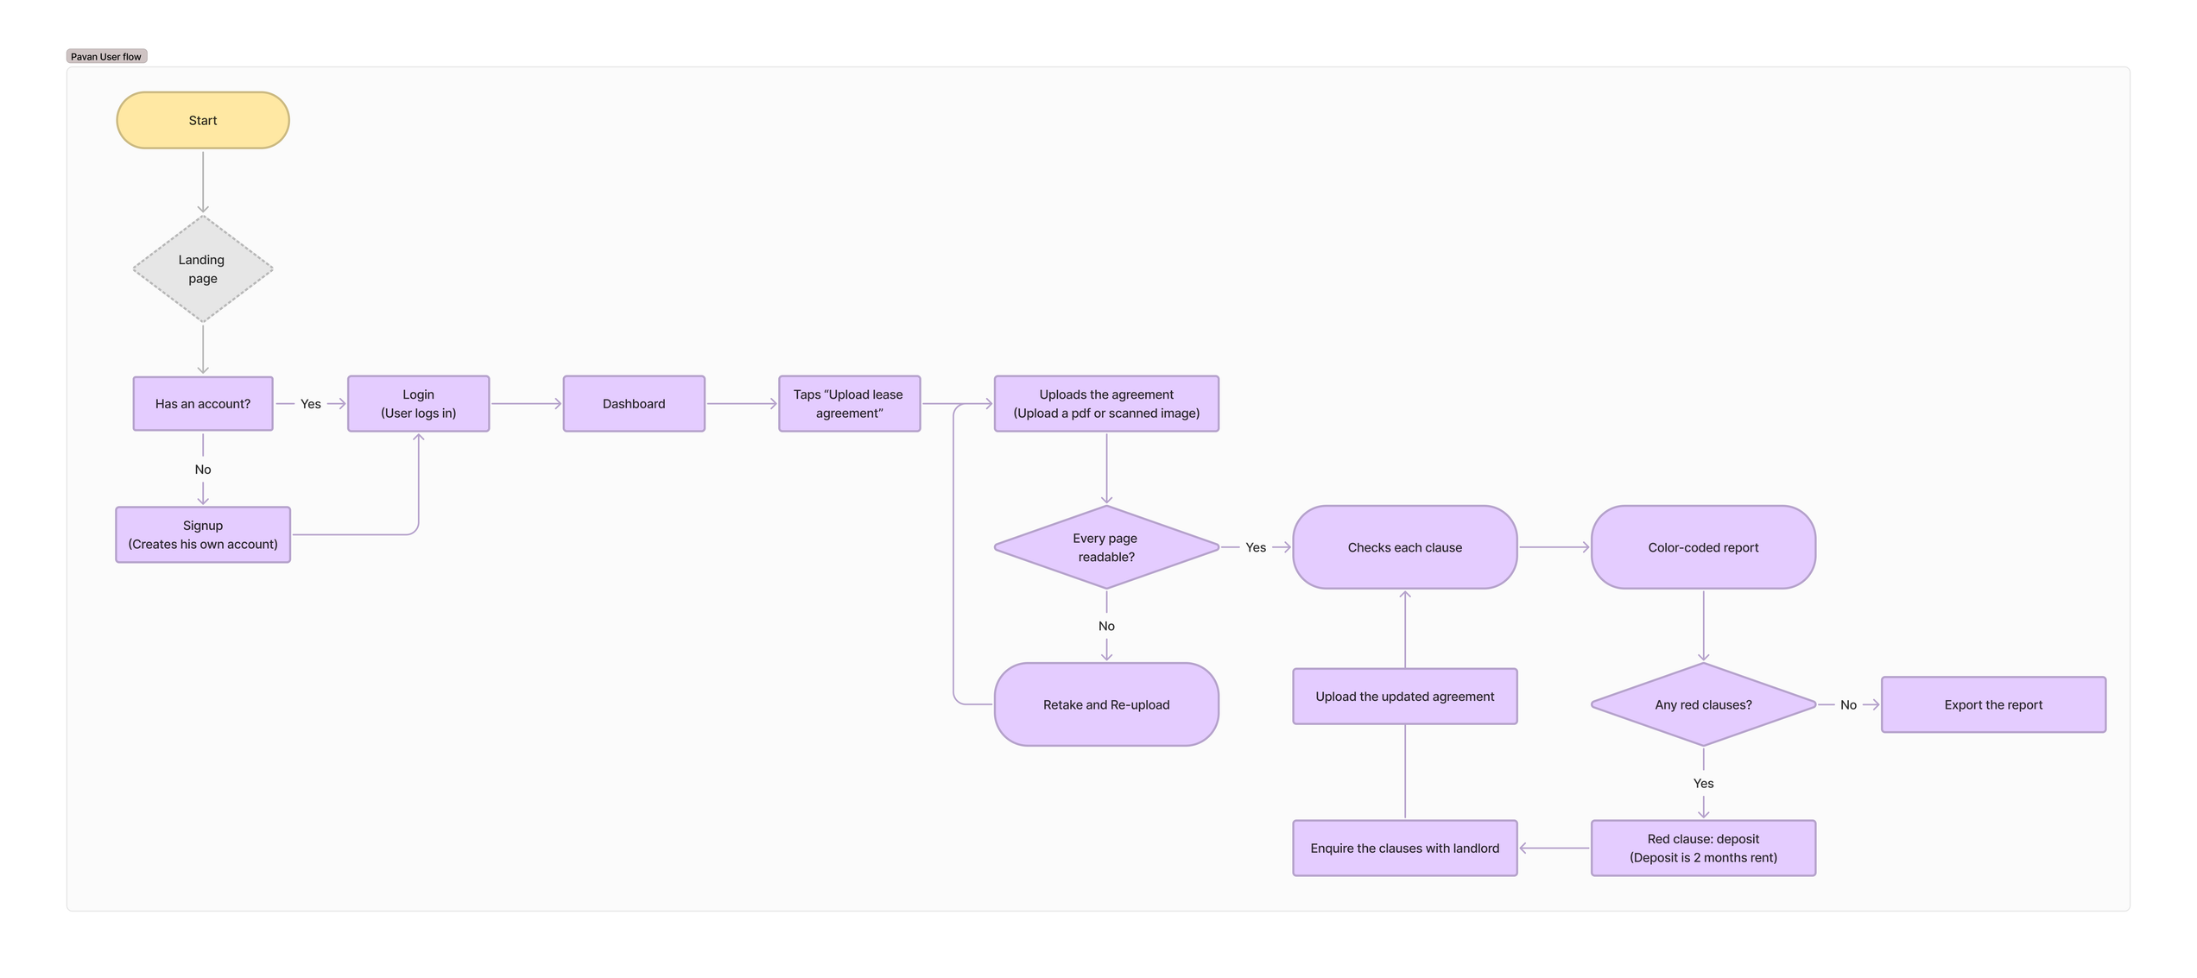
PAVAN USERFLOW

Slide 8
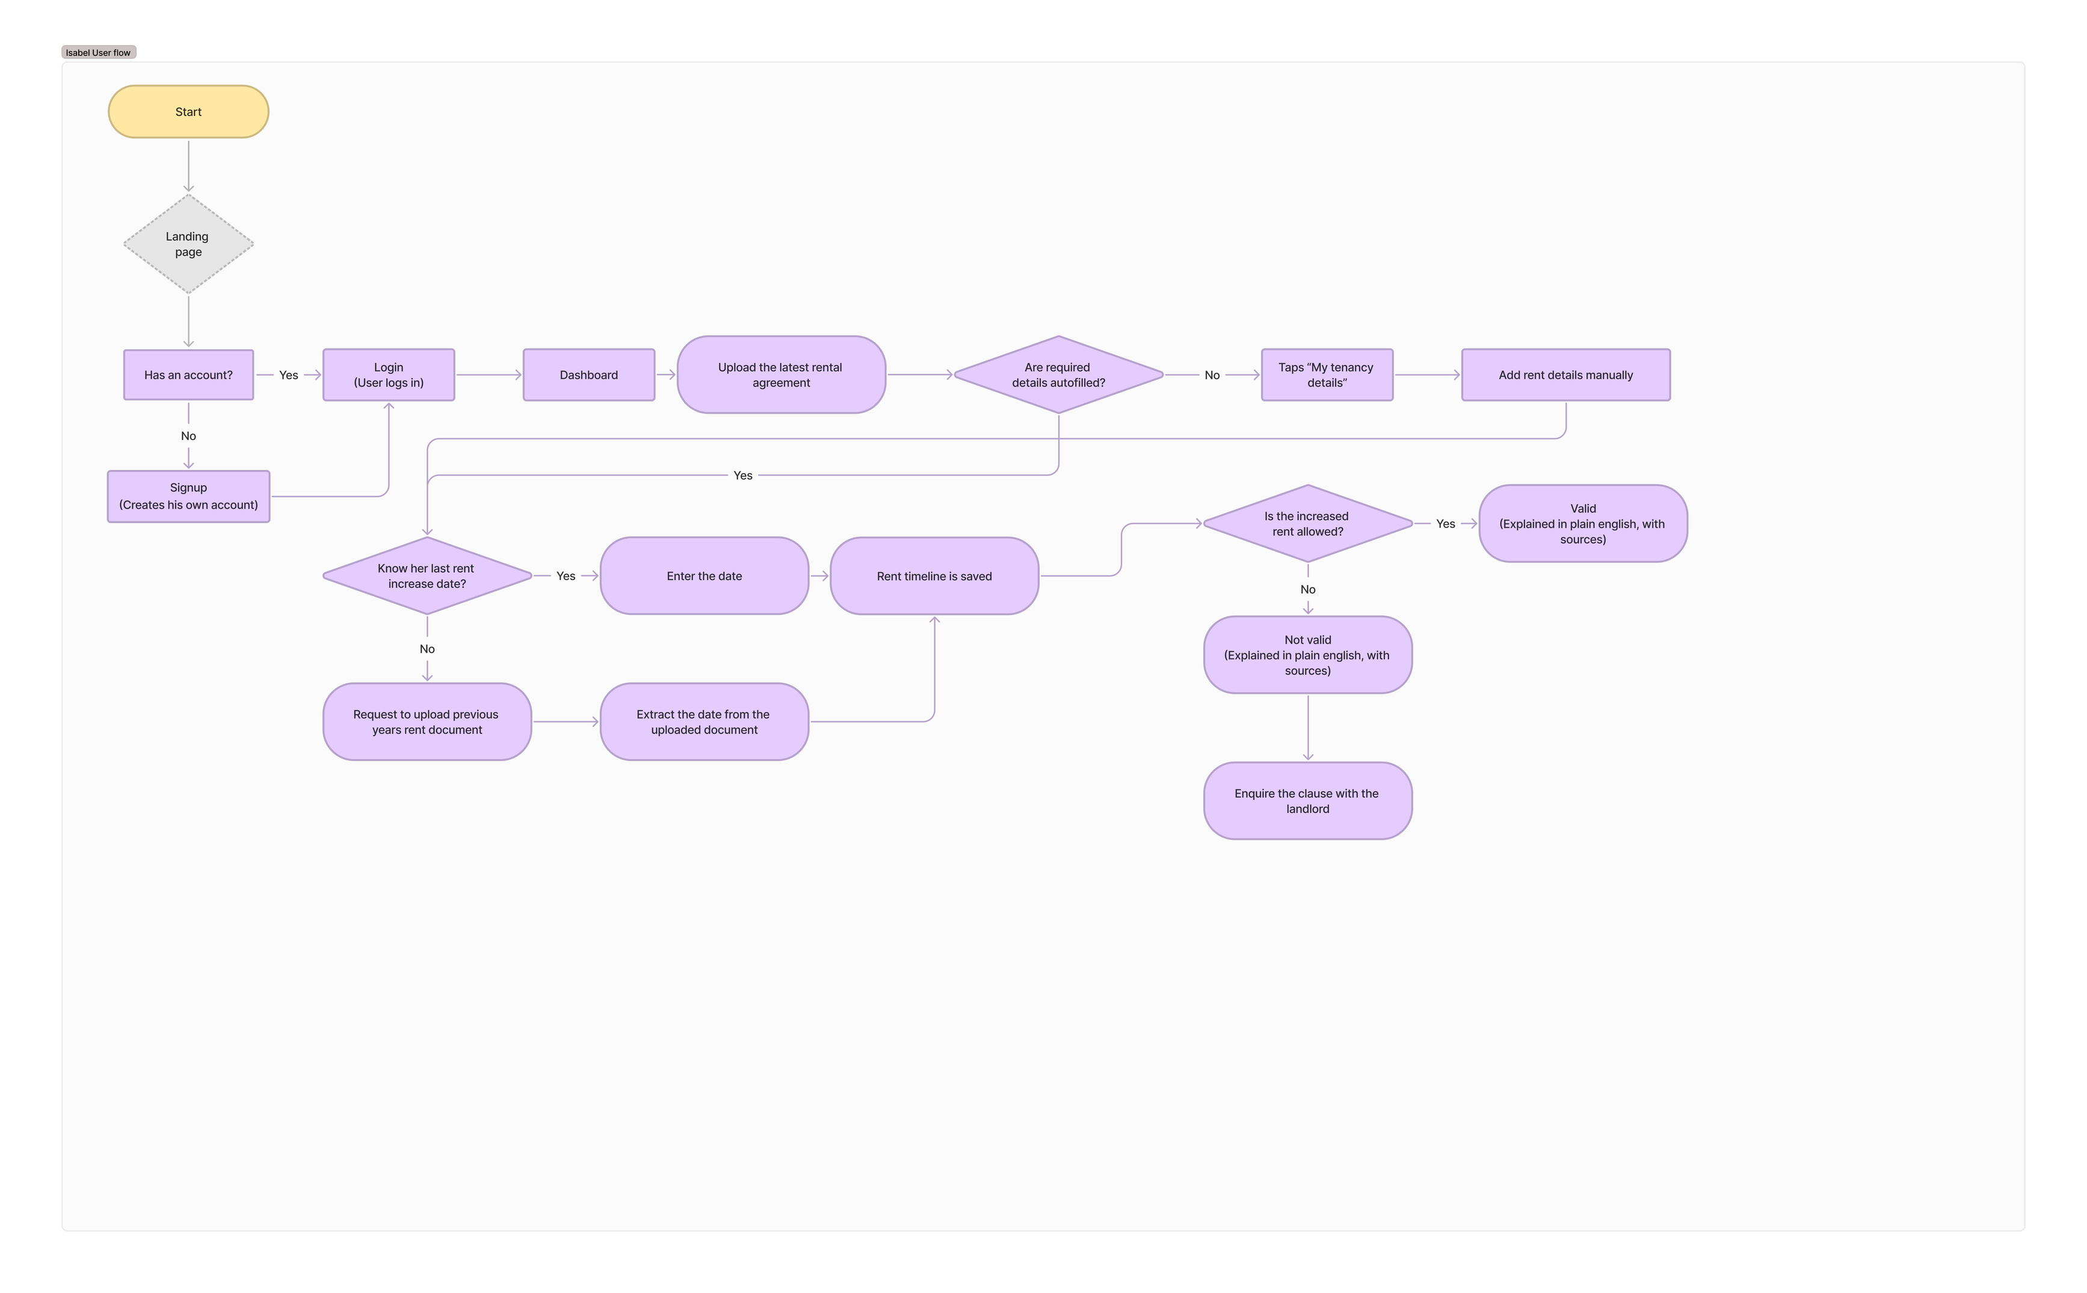
ISABEL USERFLOW

Slide 9
Lease PDF into clauses
PDF text for each page, with a check for scanned files that need OCR
it split the clauses with page numbers into a numbering point
Euro amounts and notice periods, such as €1,000 and 28 days
10 pilot clauses, with code to read, write and split them by lease
1. Read
2. Split
3. Extract
4. Label
Tested on a made-up lease and one redacted template lease. No real leases used.

Slide 10
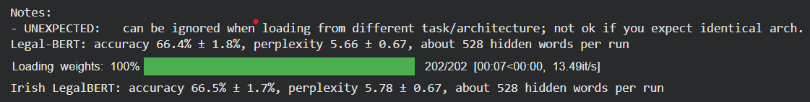
LegalBert into IrishLegalbert
How we trained it
Result on held-out Irish Acts
  Start with Legal-BERT (nlpaueb/bert-base-uncased-contracts)
  Data comes from isaacus/irish-legislative-summaries, 500 Irish Acts, CC BY 4.0 I guess.
  Task: hide 15% of words, predict them. 5,573 training blocks, 527 held out
  Perplexity (lower is better)
  3.29 → 2.52
  About 27% lower: the model now reads Irish statute wording better

Slide 11
Work Completed This Week
ClauseGuard Backend
Database Foundation
Backend API & Documentation
  Migrated the backend from PostgreSQL to MySQL using aiomysql and PyMySQL.
  Updated SQLAlchemy models, user-role mappings, UUID handling, and async database configuration.
  Created and applied Alembic migrations for users and audit_logs tables.
  Implemented Firebase authentication, token verification, role permissions, and current-user retrieval.
  Added get_token.py for local token generation and testing.
  Completed API_DOCUMENTATION.md and Postman guidance for authentication and user endpoints.

Slide 12
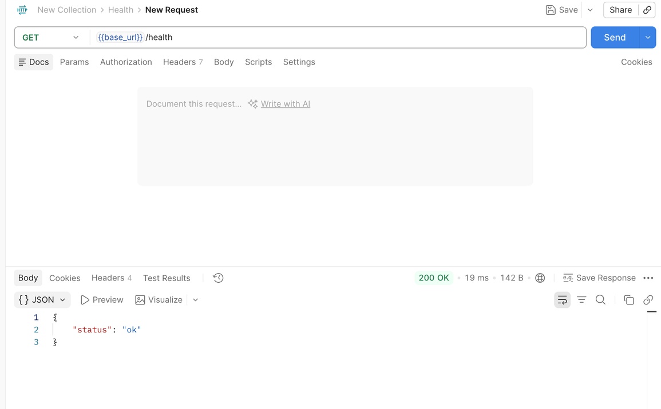
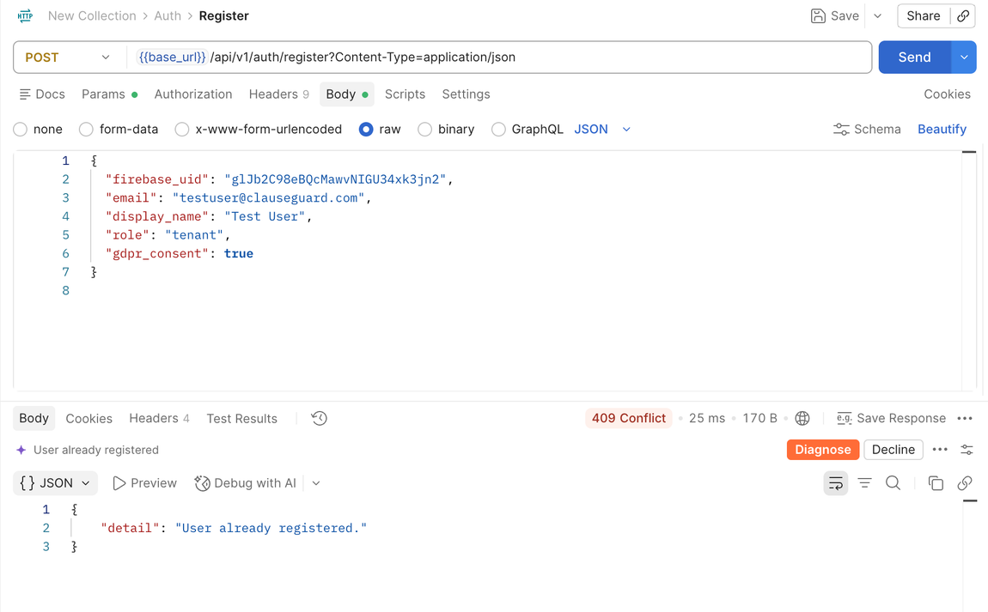
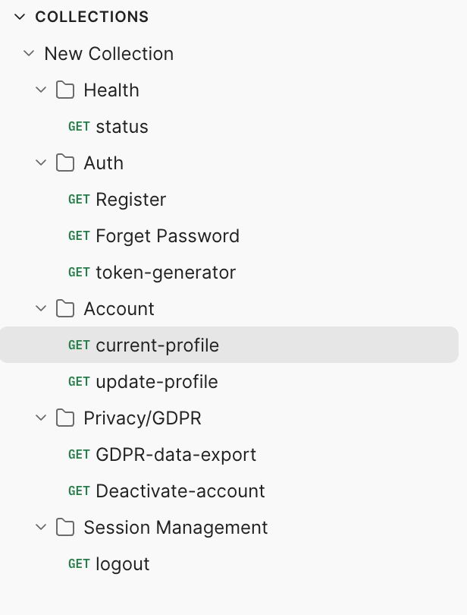
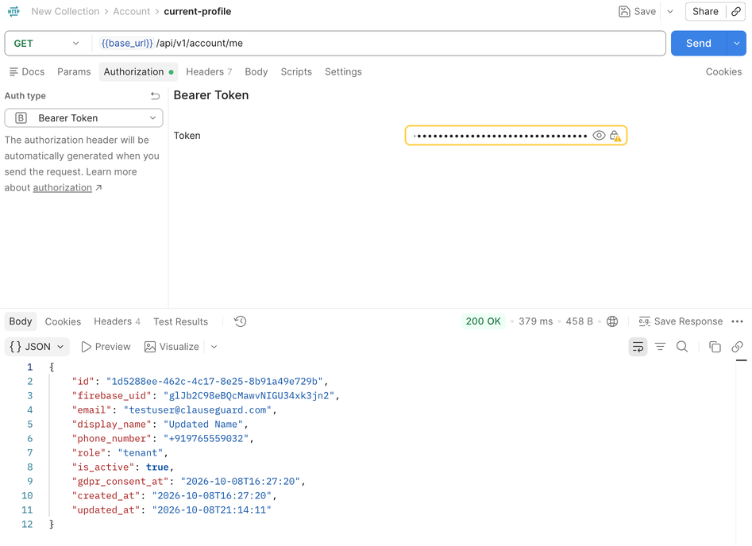
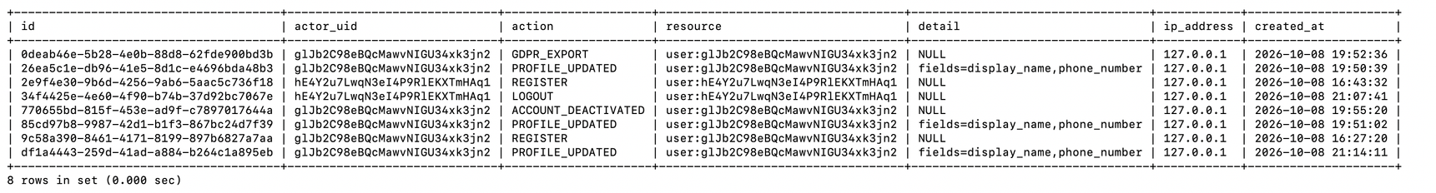
Screenshots of some API requests and Audit logs

Slide 13
Plan for next week
CORE DELIVERY ACTIVITIES
  Build FastAPI endpoints for multi-page PDF upload and document retrieval.
  Render PDFs into image pages using pdf2image and Poppler.
  Integrate Tesseract OCR through pytesseract, with DPI and image-preprocessing optimization.
  Clean extracted text: normalize whitespace and line breaks; remove invalid headers and footers.
  Persist document metadata, page text, clauses, and timestamps in MySQL with async SQLAlchemy.
  Run end-to-end validation using Pytest and Postman.
TARGET OUTCOMES
A working end-to-end pipeline that uploads a scanned PDF, extracts and cleans its text through OCR, and securely stores the output in MySQL.

Slide 14

THANK YOU

